Slide 1
Measurements in fluids
Romain MONCHAUX
IMSIA, Institute for Mechanical Sciences and Industrial Applications
ENSTA – Paris
Institut Polytechnique de Paris

Slide 2
Outlines
Pitot tube
Hot-Wires Anemometry
Laser Doppler Anemometry
Particle Image Velocimetry
Particle Tracking Velocimetry

Slide 3
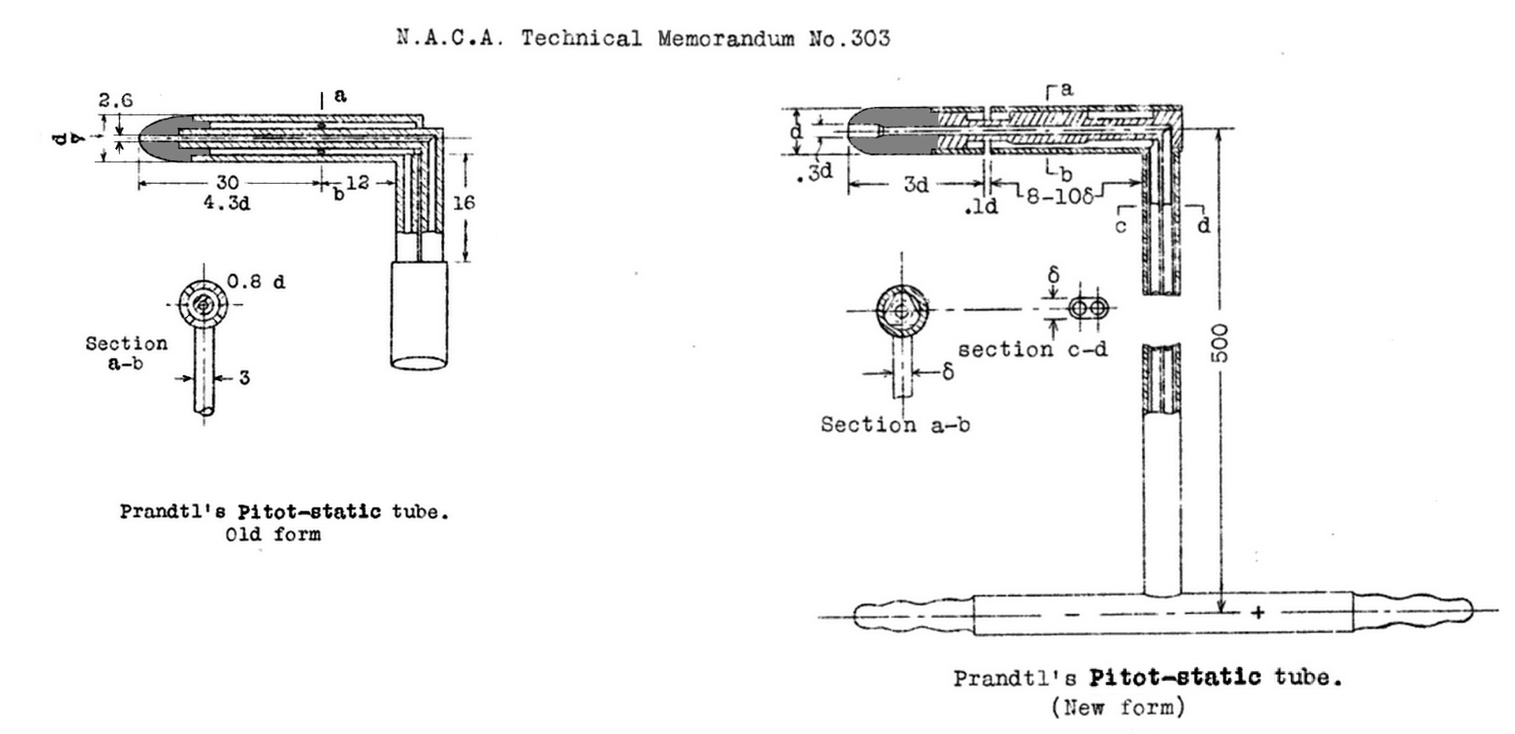
Pitot tube (from Pitot, 1732)
flow
ρ, V
Static pressure
Measurement:
Ps
Total pressure
Measurement:
Dynamic + Static
Pt = Pd + Ps
Bernoulli:
Pt – Ps = ½ ρV²

Slide 4
HWA
Hot Wire Anemometry

Slide 5

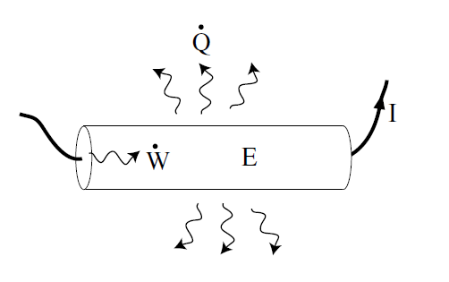

Hot Wire Anemometry
Principle
Air blowing on the wire cools the wire
« windchill effect »
Energy budget
E: energy stored in the wire
W: electrical work supplied to the wire
Q: heat extracted from the wire

Slide 6

Hot Wire Anemometry
Energy budget
E: energy stored in the wire
W: electrical work supplied to the wire
Q: heat extracted from the wire
Joule effect
Conduction to the fluid
Convection to the fluid
Conduction to the support
Radiation
negligible if the wire is very thin
neglected (admitted)

Slide 7





Hot Wire Anemometry
Principle
conduction-convection flux
: thermal conductivity of the fluid
: Nusselt number (efficiency of convection)
What is missing?

Slide 8


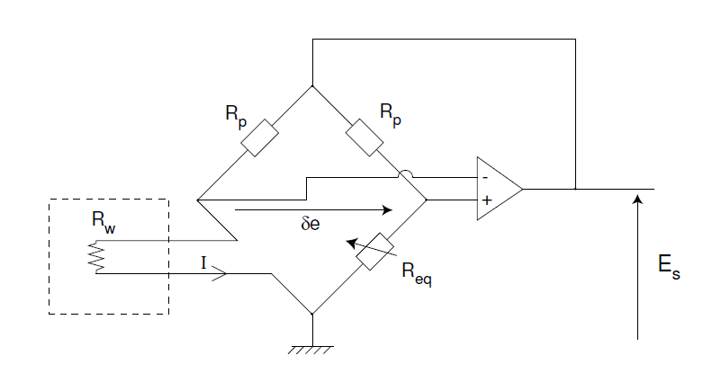



Hot Wire Anemometry
What is missing?
King’s law
Output tension:

Slide 9
Hot Wire Anemometry
King’s law
Output tension:

Slide 10
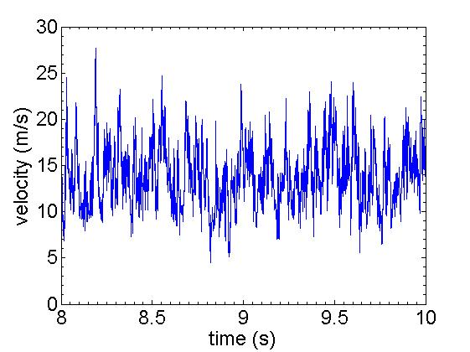
Hot Wire Anemometry: characteristics and example
Measure in a turbulent jet:
Characteristics:
Electronic conditioning
Sampling frequency ~ 50kHz
Spatial resolution: wire length
Intrusive method
Use:
Fluid mechanics in gas or liquids (hot films)
X-wire or wire arrays for gradients and multi-components acquisition

Slide 11
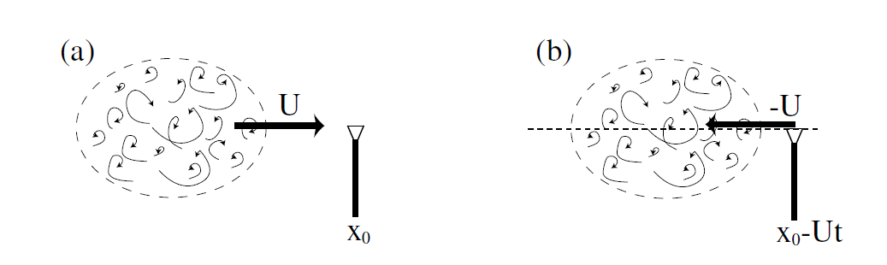

Hot Wire Anemometry
Taylor’s hypothesis
From 1 point time signal to 1 time space signal
Frozen turbulence

Slide 12
LDA
Laser Doppler Anemometry

Slide 13
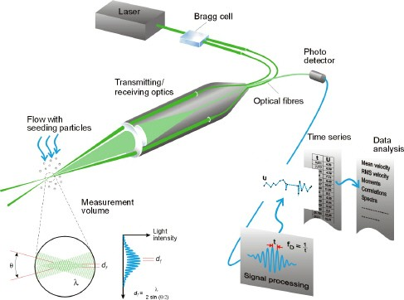
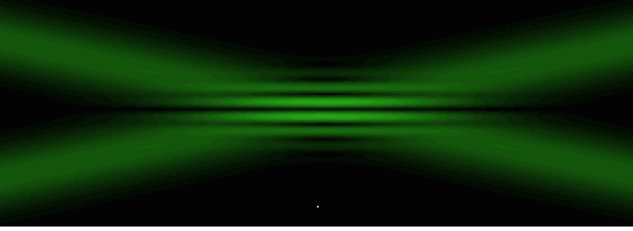
Laser Doppler Anemometry: principles
LDA material:
Seeding particles
Two interfering Laser beams
Optics
Bragg cell
Photo receptor
1 good computer
LDA input:
1D light intensity signal
LDA output:
1 velocity time signal
from DANTEC

Slide 14
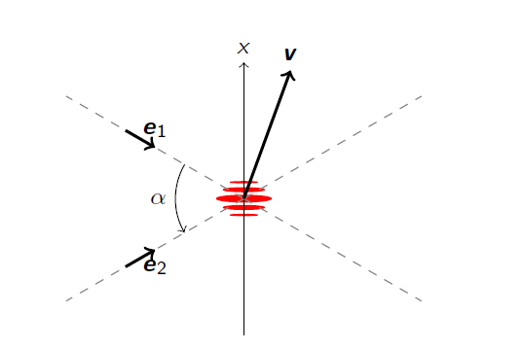
Laser Doppler Anemometry: principles
Measuring velocity
Light change with particle displacement
Fringe spacing: d
Velocity along x: v sin(α)
Brightness frequency: f
f = v sin(α) / d
Where is the Doppler effect?

Slide 15
Laser Doppler Anemometry: principles
Bragg cell:
Interfering pattern moves
Allows sign measurement
Allows zero measurements
from DANTEC

Slide 16
PIV
Particle Image Velocimetry

Slide 17
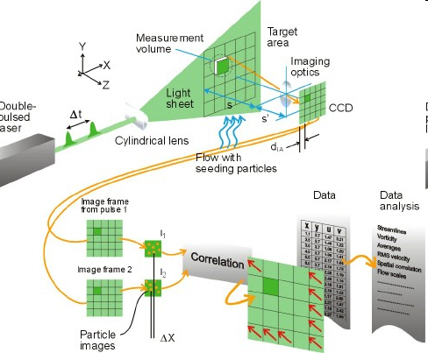
Particles Image Velocimetry: principles
PIV material:
Seeding particles
1 double pulse Laser
1 cylindrical optic
1 or 2 cameras
1 good computer
PIV input:
Pair of images
PIV output:
2D velocity fields
from DANTEC

Slide 18
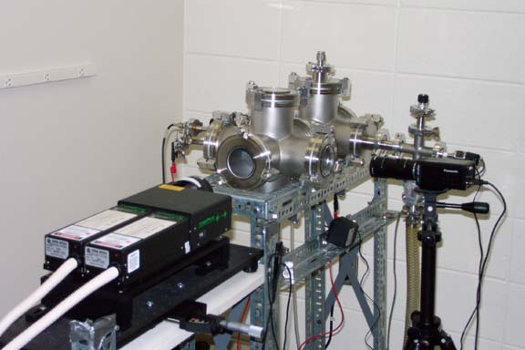
Particles Image Velocimetry: example
In a combustion jet

Slide 19
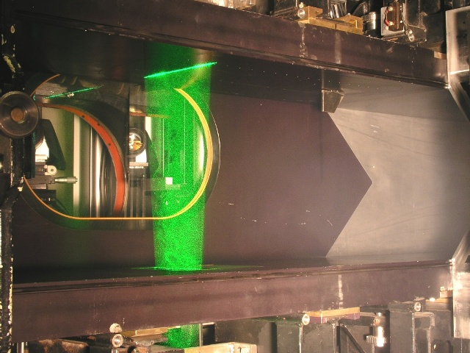
Particles Image Velocimetry: example
In a water channel

Slide 20
Particles Image Velocimetry: principles
PIV material:
Seeding particles
1 double pulse Laser
1 cylindrical optic
1 or 2 cameras
1 good computer
PIV input:
Pair of images
PIV output:
2D velocity fields
from DANTEC

Slide 21
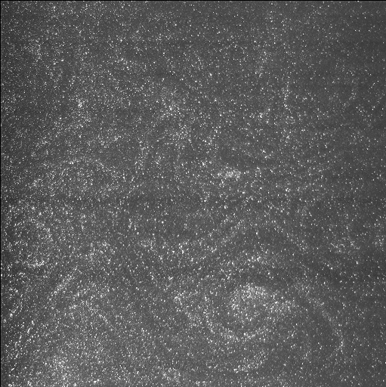
Frame 1

Slide 22
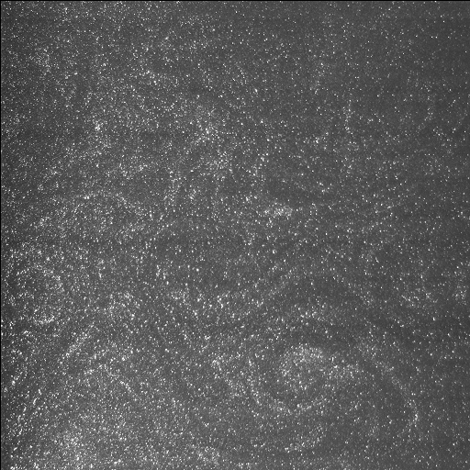
Frame 2

Slide 23
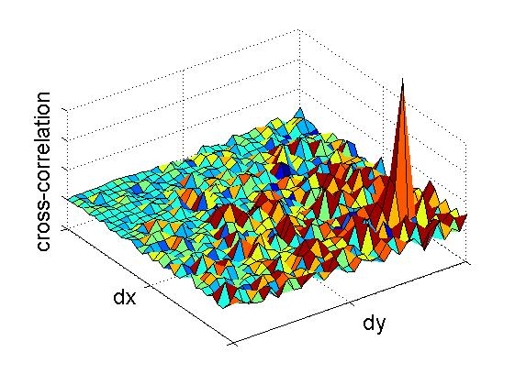
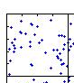
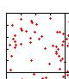
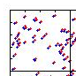

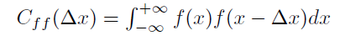
Particles Image Velocimetry: principles
Frame 1
Frame 2

Slide 26
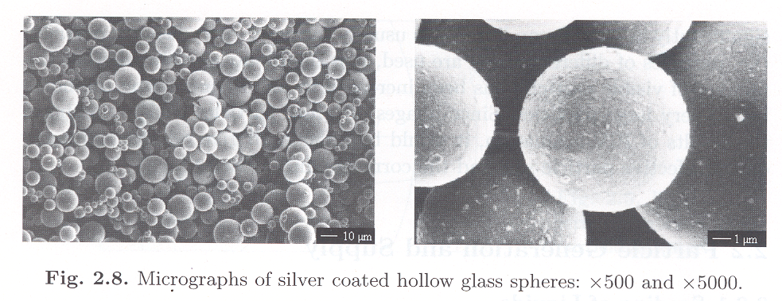
Particles Image Velocimetry: principles
PIV parameters:
Particles type
Light budget - pulse duration
Time between pulses (Δt)
Acquisition frequency (Fs)
Windows/interrogation areas sizes
Possibly multiple passes (moving or not)
Correlation calculation
PIV time line
Δt
time
1/Fs
from DANTEC

Slide 27
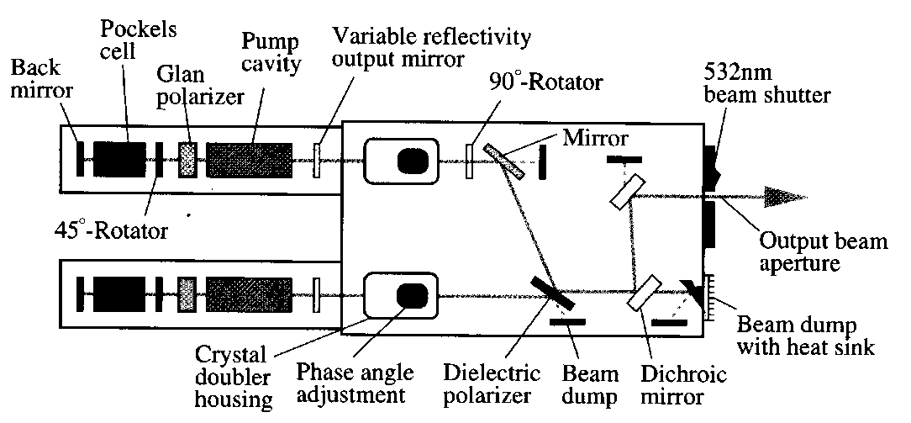
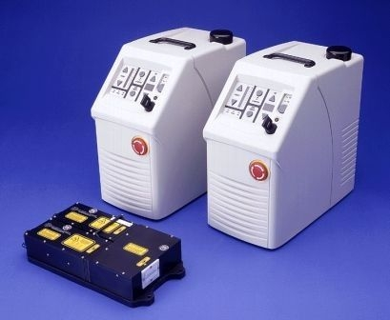
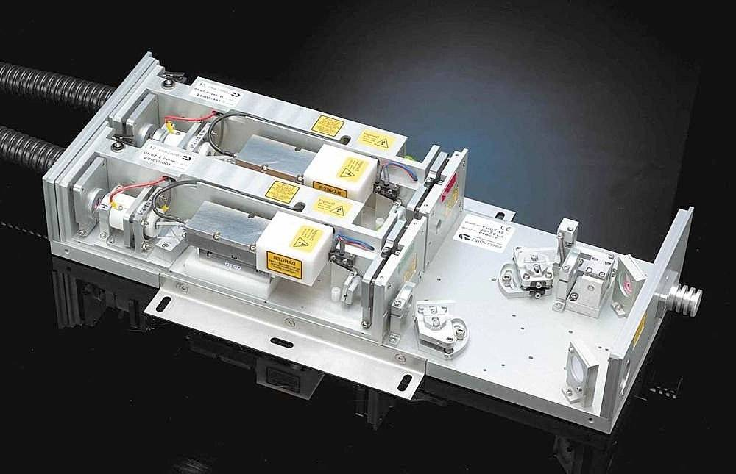
Particles Image Velocimetry: material
Laser: double pulsed

Slide 28
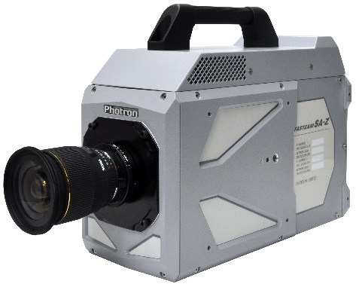
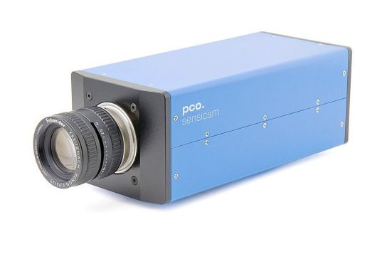
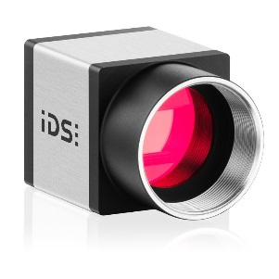
Particles Image Velocimetry: material
PIV cameras
 | Caméras standards | Caméra double-frame | Caméras rapides (RAM interne)
Capteur | CCD 10 – 12 bits (1024 à 4096 n.g.) | CCD 12 – 14 bits (4096 à 16384 n.g.) | CMOS 12 bits
Résolution | 1000² 2000² 20 - 100 Hz | 1000² 2000² 2x4 à 2x30 Hz | 1000² 0.5 à 10 kHz
Prix | 0.5-1 k€ | 5 – 20 k€ | 20-60 k€

Slide 29
Particles Image Velocimetry: material
Calibration target
Matching real world coordinates and picture coordinates

Slide 30
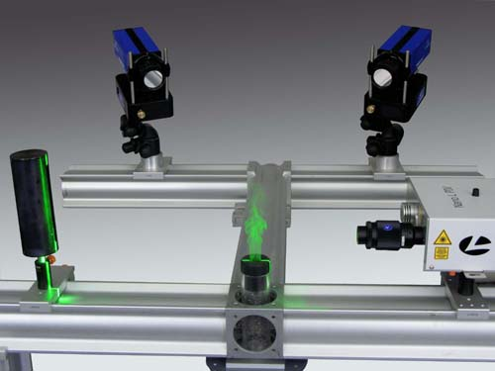
4 - PIV stéréoscopique (3C2D)

Slide 31
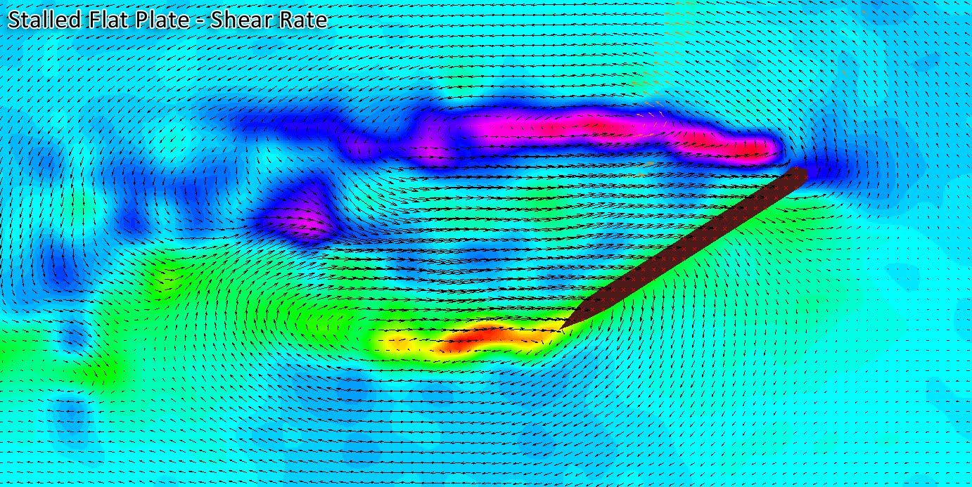
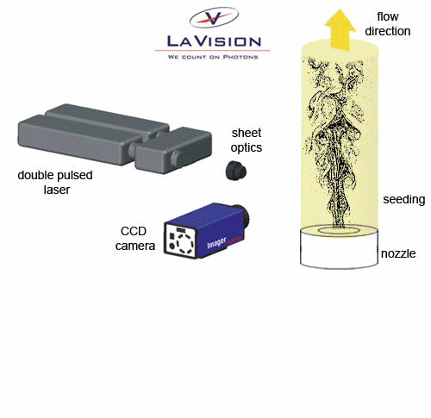
Particles Image Velocimetry: characteristics and example
Characteristics:
Sampling frequency below 15Hz or up to few kHz
Spatial resolution: box sizes
Use:
Fluid mechanics in gas or liquids
Stereoscopic for three components measurements
Moving laser sheets for 3D measurements

Slide 32
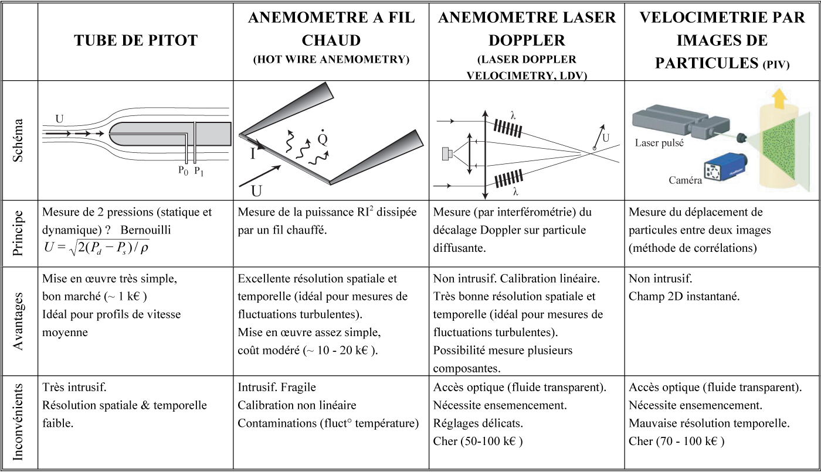
Velocity measurements
 | Pitot Tube | Hot Wire Anemometry | Laser Doppler Anemometry | Particle Image Velocimetry
Sketch
Principle | Two pressure measurements: static and dynamics Bernoulli | Measure of dissipated Joule power in a wire | Interferometric measurement of a Doppler shift on scattering particle | Pattern displacement between two images (correlation)
Pros | Easy to use Cheap (1 k€) Suited for time average | Very high time and space resolution Suited for fluctuation measurements Easy to use Medium price (10 k€) | Non intrusive High time and space resolution Suited for fluctuations Suited for several components | Non intrusive 2D measurements 2 or 3 components
Cons | Highly intrusive Very poor time & space resolution | Intrusive, fragile Non linear calibration Sensitive to temperature | Non regular sampling High price (50-100 k€) Seeding required Difficult settings | Poor time resolution High price (100 k€) Seeding required

Slide 33
Particles Image Velocimetry: principles
Typical velocity fields:
Possible spurious vectors
Checking resolution of gradients
First step before statistical/Fourier analysis

Slide 34
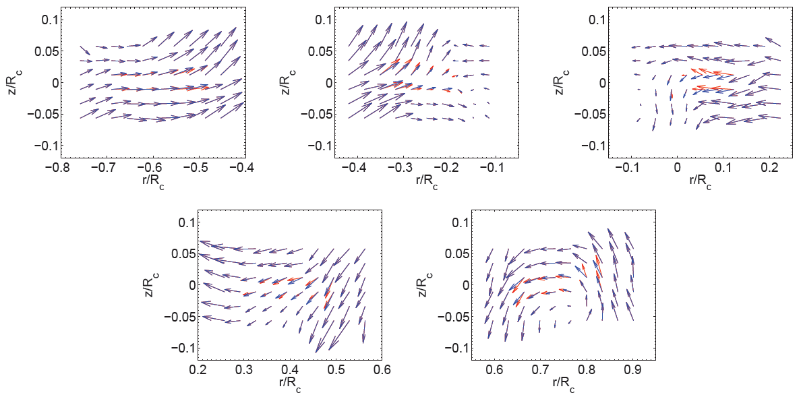
Particles Image Velocimetry: principles
Removing spurious vectors:
Isolating them:
  Absolute thresholds
  Local thresholds
Replacing them:
  Moving average

