Slide 1
Modeling and simulation of diffusion MRI signal in biological tissue
Institut national de recherche en informatique et en automatique (INRIA)
Centre Saclay (Equipe-projet DEFI )
Centre Nancy (Equipe-projet TOSCA)
Coordinateur: Jing-Rebecca Li
Participants: Houssem Haddar, Armin Leichleiter, Antoine Lejay
PhD: Dang Van Nguyen
Commissariat à l'Énergie Atomique (CEA)
Neurospin
Coordinateur: Cyril Poupon
Participants: Denis LeBihan
PhD: Benoit Schmitt, Alice Lebois, Hang Tuan Nguyen

Slide 2
Modeling by PDEs Simulation of PDEs
Probabilist processes Simulation by Monte-Carlo
Inverse problems
Simulation by Monte-Carlo
MRI data acquisition
Bio-physics

Slide 3
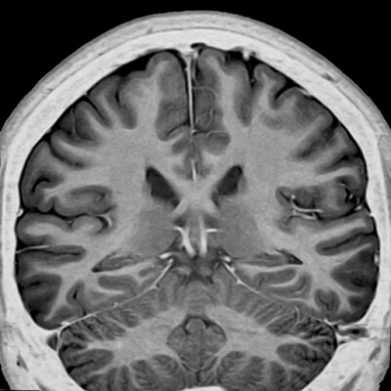
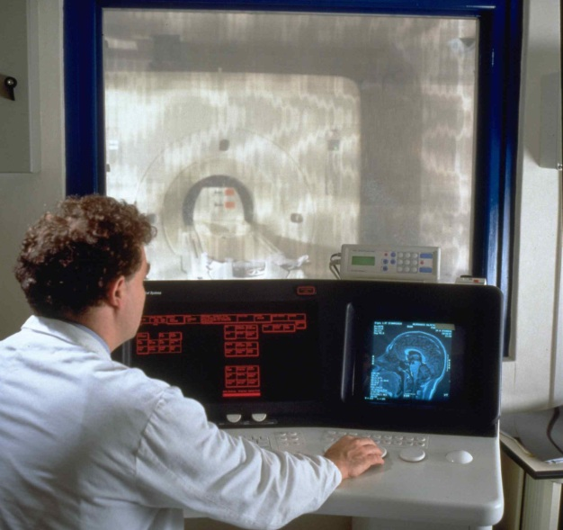
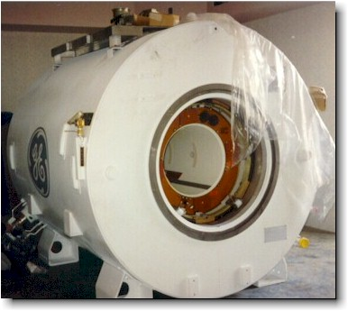
Magnetic resonance imaging
MRI
1,5Tesla magnet (15000 Gauss)
Contrast: (tissue structure)
1. water magnetization (spin density)
2. relaxation (T1,T2,T2*)
3. water displacement (diffusion)
in each voxel
One voxel = O(mm)
Notes:
Aimantation de l’eau

Slide 4
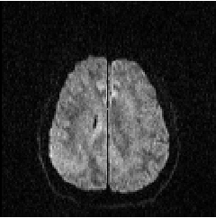
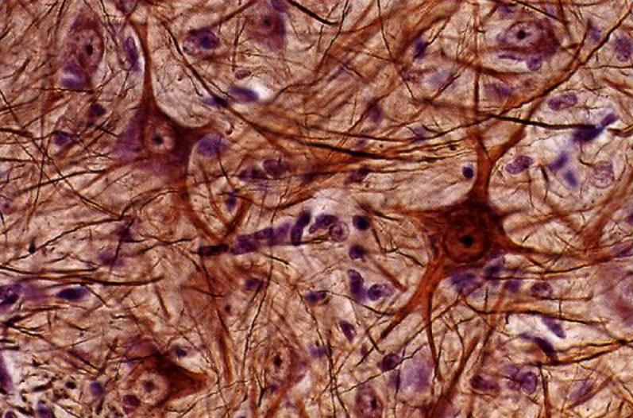
Diffusion MRI
Diffusion MRI can measure displacement of water
Displacement of water can tell us about cellular structure
Understanding of biomechanics of cells, structure of brain
Potential clinical value
  Structure change in diseases
  cells swell immediately after stroke.
Functional studies
Human visual cortex
(Le Bihan et al. PNAS 2006).
Free diffusion:
ln(S/S0) = -bD
Slope is ADC (apparent diffusion coefficient)

Slide 5
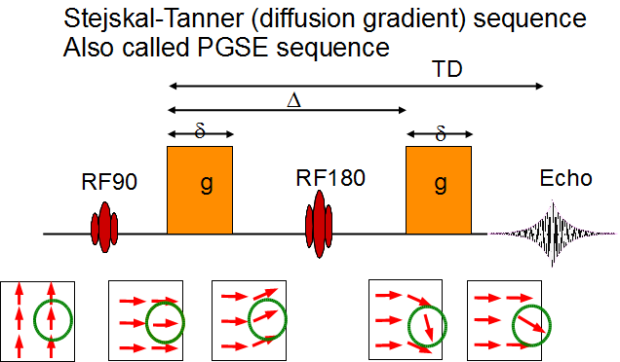
Apply magnetic fields

Slide 6
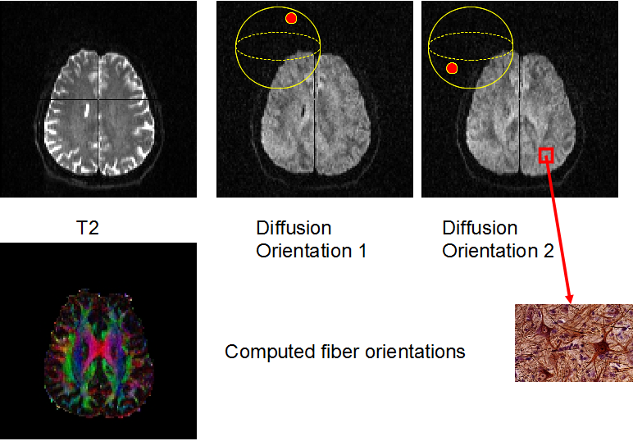

Slide 7
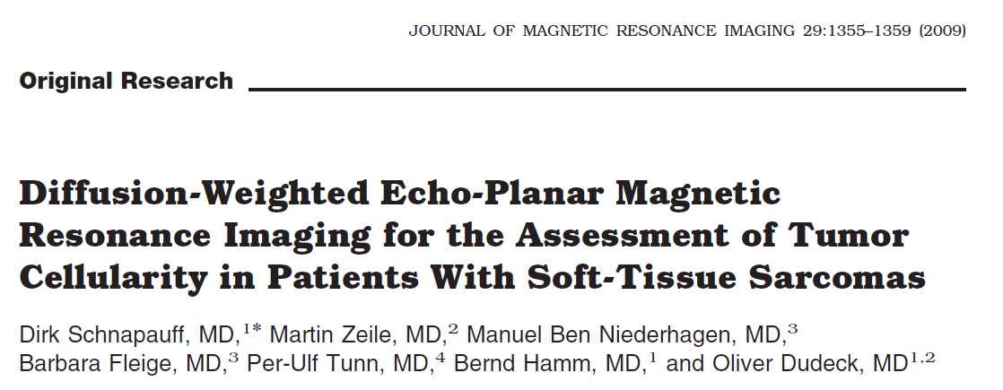
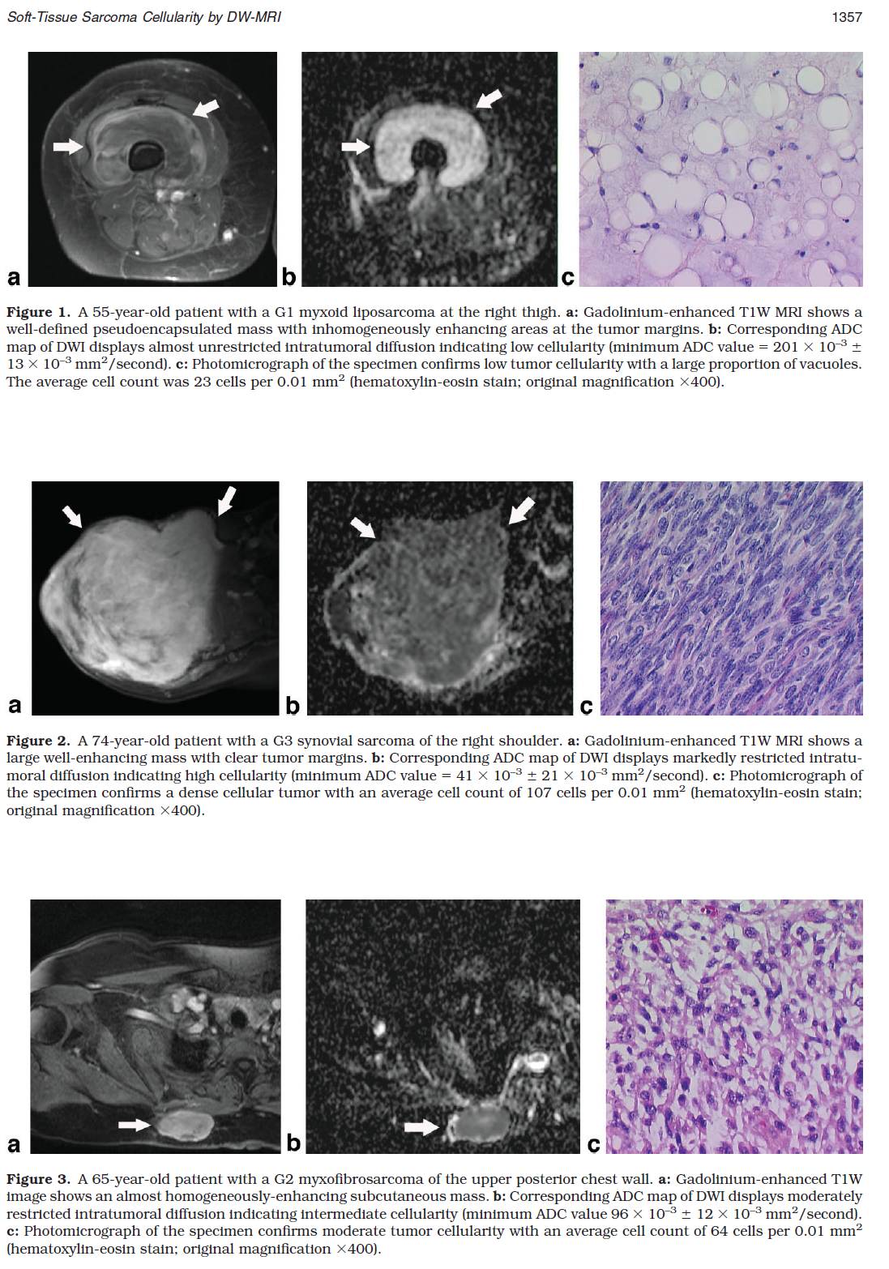
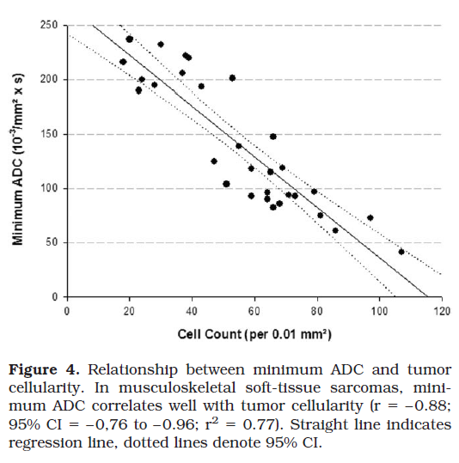

Slide 8
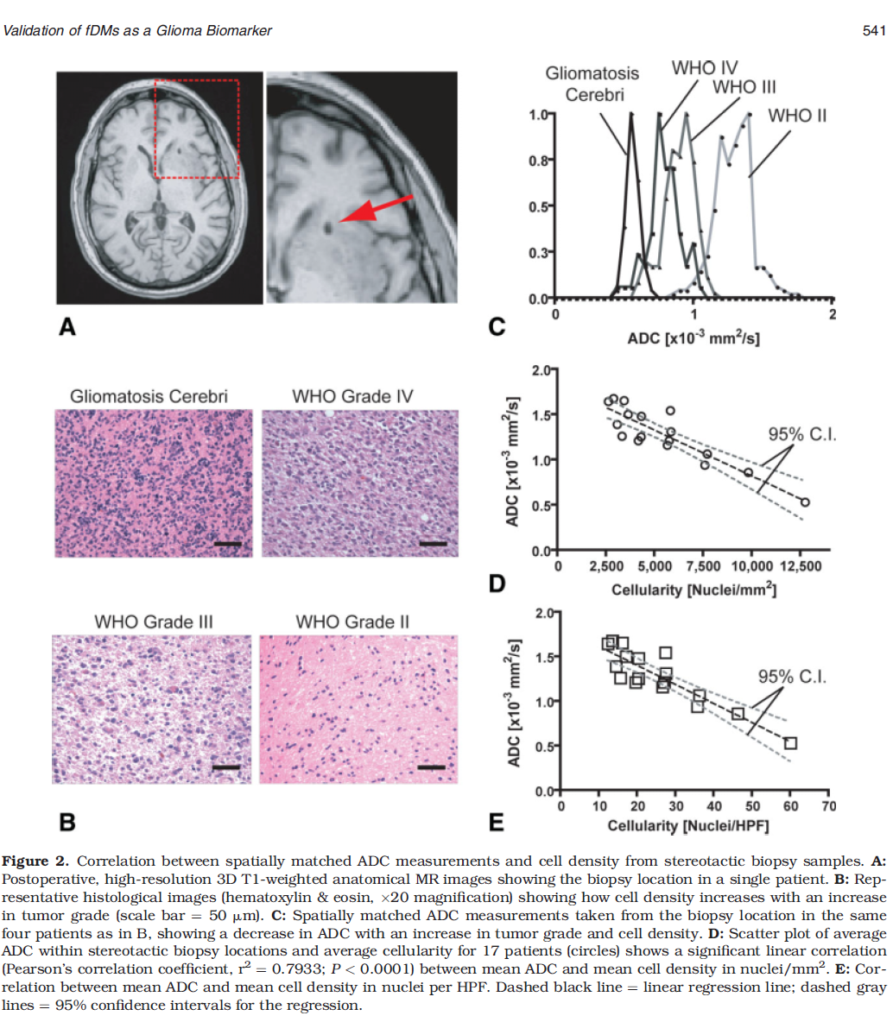
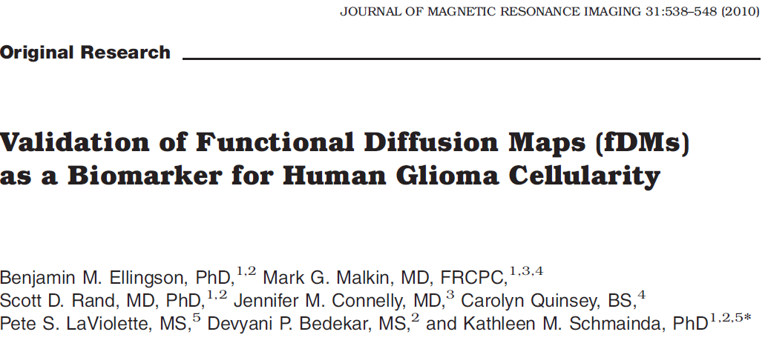

Slide 9
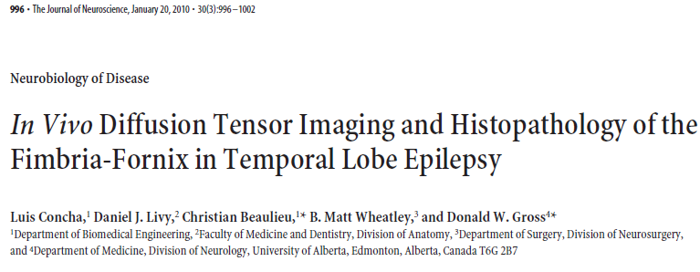
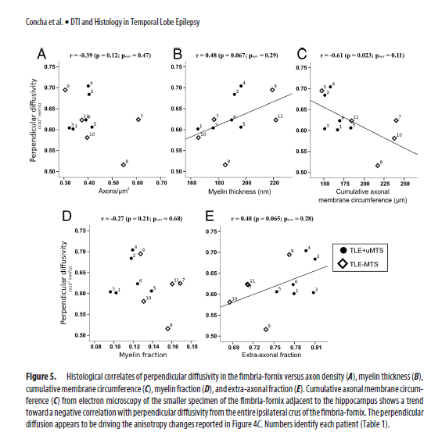
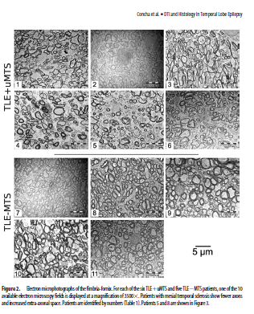

Slide 10
Step 1. Simulation
Human visual cortex
(Le Bihan et al. PNAS 2006).
Free diffusion:
ln(S/S0) = -bD
Slope is ADC (apparent diffusion coefficient)
Later: inverse problem

Slide 11
Step 1. Simulation
Partial differential equation model “Bloch-Torrey PDE”
Permeable membranes
Simpler cellular geometry
Easier theoretical analysis
Monte-Carlo simulation of random walkers, representing concentrated mass of water molecules.
Impermeable membranes for now.
More flexible cellular geometry

Slide 12
Bloch-Torrey PDE
2or 3 compartment diffusion model
‘IC’
‘IC’
‘MEM’
=permeab coeff
‘MEM’
‘EC’
‘EC’
IC, EC: Intra-, extracellular space
MEM: membrane-bound layer

Slide 13
FVforDMRI: written in Fortran90,
C++ version in development
10000 lines.
Authors: Jing-Rebecca Li, Dang Van Nguyen
Simulation by FVforDMRI of
Diffusion MRI signals
in complicated cellular environment

Slide 14
Simulation by FVforDMRI
ADC as a function of cell density

Slide 15
C++ version in development
Authors: Jing-Rebecca Li, Dang Van Nguyen

Slide 16
Benoit will speak about the Monte-Carlo code at the end
Planned work:
Antoine Lejay and Jing-Rebecca Li will define the interface condition to mimic permeability membranes to add to the Monte-Carlo code. Also add Green’s function analytical solution for random walkers when they are far from any interfaces.

Slide 17
Step 2: Inverse problem.
Find reduced (ODE model), improved from existing model (Karger model)

Slide 18
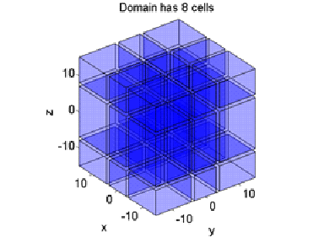
Step 2: Inverse problem
Solved inverse problem for average cell size, improved over Karger model.
Numerically verified for simple geometry

Slide 19
Step 3: Experimental verification (began Jan 2012)
Imaging rat brains on the 17T Brucker small animal system at Neurospin.
Preliminary experimental data have been obtained.
Histology on the tissue samples is planned so as to provide the necessary geometrical parameters to input into the two codes.
Reduced (ODE) model will be use to estimate average cell size.

Slide 20
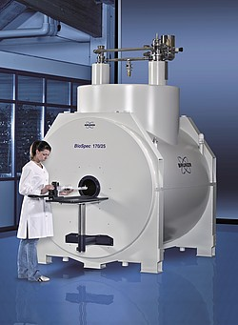
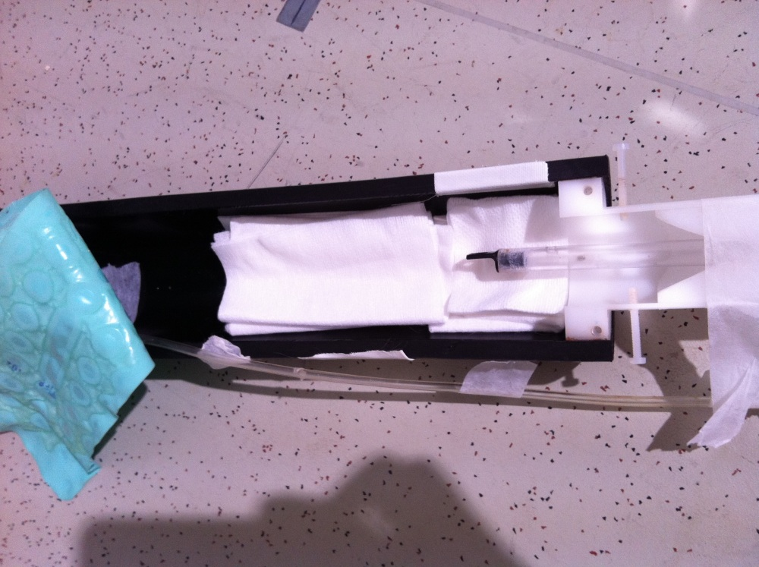
Step 3: Experimental verification
Imaging rat brain
17T Brucker small animal system
Imaging bed for rat

Slide 21
Step 3: Experimental verification
Imaged 6 rats
DMRI signal

Slide 22
Step 3: Experimental verification
Tumor model in rat
Imaging tumor in rat brain

Slide 23
Work program
  Tache 1: The numerical method based on PDEs. It is written in Fortran90 and contains about 10000 lines. Completed.
  Tache 1.1: Ph.D. student Dang Van Nguygen (funded by ANR) is implementing a C++. Ongoing.
  Tache 2: New reduced ODE model can estimate cell size. Completed. Theory completed. Experimental verification ongoing.
  Tache 3: Monte Carlo Brownian dynamics simulator capable of simulating diffusion of spins in arbitrarily complex geometries with a diffusion weighted signal integrator emulating various MR pulse sequences. Implemented in C++ on a high computing PC cluster for large-scale simulations. It contains 17000 lines of C++ code and 4000 lines of python code. Completed.

Slide 24
Work program
Tache 4: Imaging rat brains on the 17T Brucker small animal system at Neurospin. Preliminary experimental data have been obtained. Histology on the tissue samples is planned so as to provide the necessary geometrical parameters to input into the two codes. We plan to verify the simulation results of both the PDE method (‘FVforDMRI’) and the Monte-Carlo method (‘Microscopist’) against the experimental data obtained in rat brain on the 17T imaging system. Ongoing.
Tache 5: The Green’s function formalism gives an interface condition that must be satisfied on the cellular membranes by any Monte-Carlo simulation so that the simulation results can be compared in a meaningful way with the PDE simulation results. This interface condition will be implemented in the Monte-Carlo code. We plan also to begin accelerate the Monte-Carlo code by incorporating known Green’s function solutions in parts of the computational domain that are homogeneous. Planned.
Tache 6 : We have begun to evaluate different ways of acquiring sample brain geometries using electron microscopy in order to extract more realistic membrane geometries to be used as input to ‘Microscopist’. Ongoing.

Slide 25
Joint (journal) publications
Li J.-R., Nguyen T.Q., Haddar H., Grebenkov D., Poupon C., Le Bihan D., Numerical and analytical models of the long time apparent diffusion tensor, preprint
Li J.-R., Nguyen H.T., Grebenkov, D., Poupon C., Le Bihan D., General ODE model of diffusion MRI signal attenuation, preprint
Li J.-R., Calhoun D., Poupon C., Le Bihan D., Efficient numerical method to solve the multiple compartment Bloch-Torrey equation, preprint
Yeh CH, Le Bihan D., Li J.-R., Mangin J.-F., Lin C.-P., Poupon C., Monte-Carlo simulation software dedicated to diffusion-weighted MR experiments in neural media. (Submitted to NeuroImage)
Yeh CH, Kezele I., Schmitt B., Li J.-R., Le Bihan D., Lin C.-P., Poupon C., Evaluation of ﬁber radius mapping using diffusion MRI under clinical system constraints. (Submitted to Magnetic Resonance Imaging)

